Slide 1
Case Study 2: Hackathon
Gold Atlantis: Repaying the Credit
- Rohan Deshmukh

Slide 2
Task for Eda analysis
Analyze the credit data of Gold Atlantis, figure out various patterns in the data, and make interpretations.
The aim of this analysis is to help the firm identify those customers who have a lower probability of becoming a defaulter.

Slide 3
Flow of program
Saving Data provided in to data frame for analysis
Checking for null values if any replacing it delete those values
Differentiating which columns are numerical and categorical
Getting mean, standard deviation and median for numerical columns and for categorical columns we are finding mode and unique values
By studying data get the columns which we think are important for analysis
Then give condition as per the requirement and do analysis
Give optimal output for all analysis

Slide 4
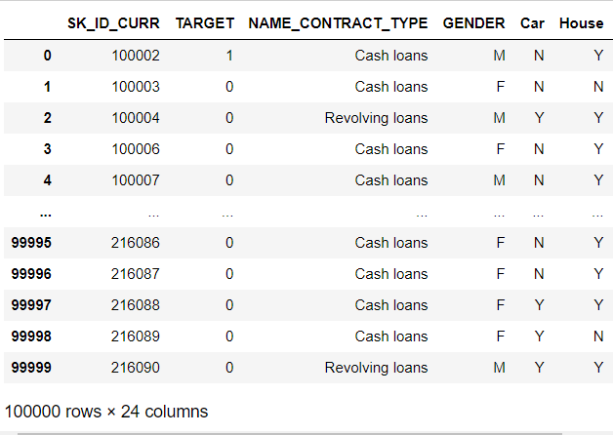
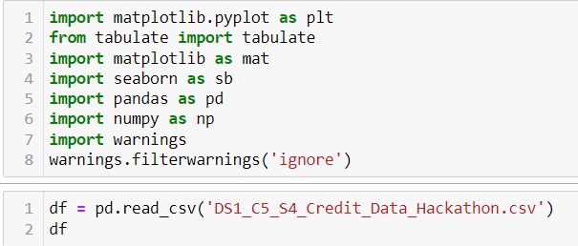
Step 1:
Importing libraries , storing data into dataframe
input
output

Slide 5
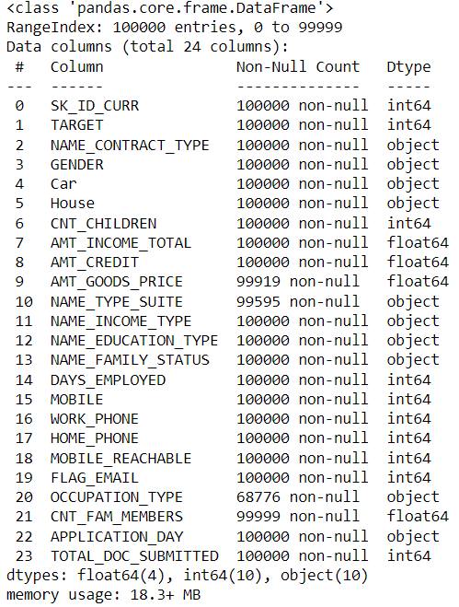

Step 2.1:
Checking information of data and number of null values in the data
input
output

Slide 6
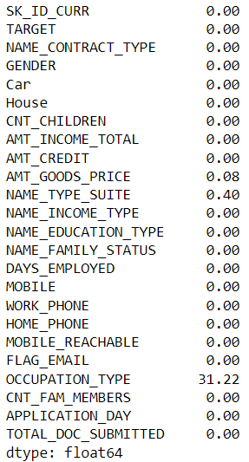
Step 2.2:
input
output

Slide 7
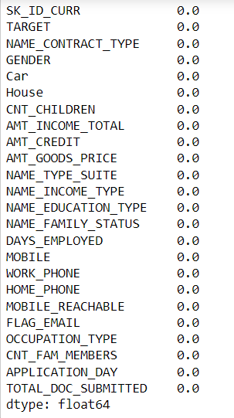
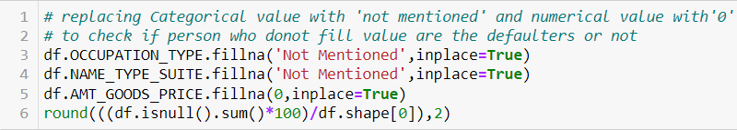
Step 3:
Replacing null values with appropriate values since its financial data even null value matters
input
output

Slide 8
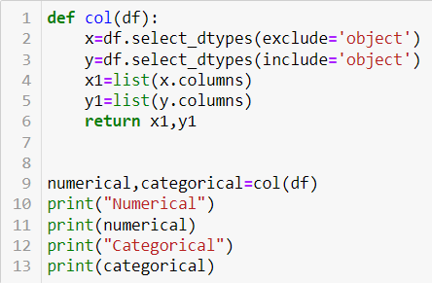
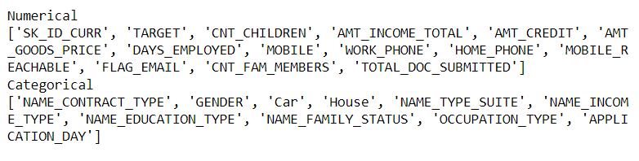
Step 4:
Differentiating columns type Numerical and Categorical
input
output

Slide 9
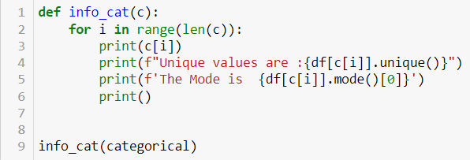
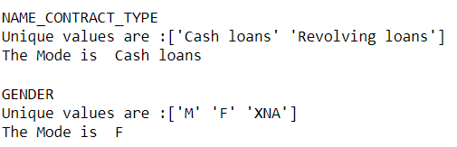
Step 5.1:
Getting mean, standard deviation and median for numerical and for categorical finding mode and unique values
input
output

Slide 10
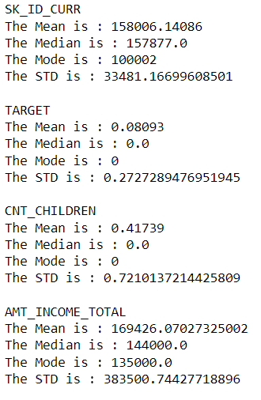
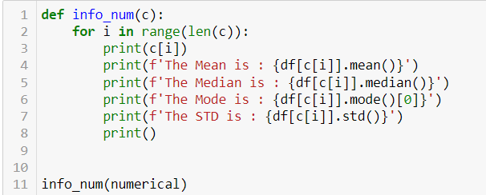
Step 5.2:
input
output

Slide 11
According to my understanding and thought process I concluded with these column which help us to know how most likely going to be defaulter:
Target
Using the above column we are going to find some relation with different columns with that we can know which values are most likely to become defaulter
So that we can say who have less probability to become defaulter
By using Bi-Variant analysis we are able to get the optimal solution

Slide 12
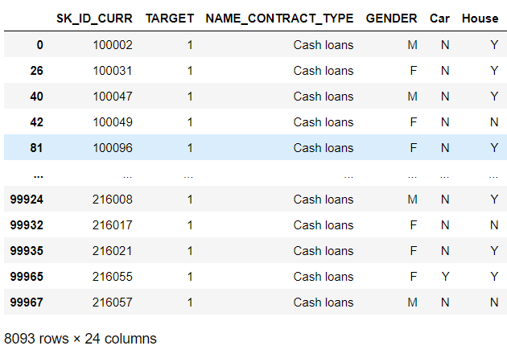
Step 6:
Creating new data frame only where target is 1 means at fault
input
output

Slide 13
Step 6:
Creating new data frame only where target is 1 means at fault
input
output

Slide 14
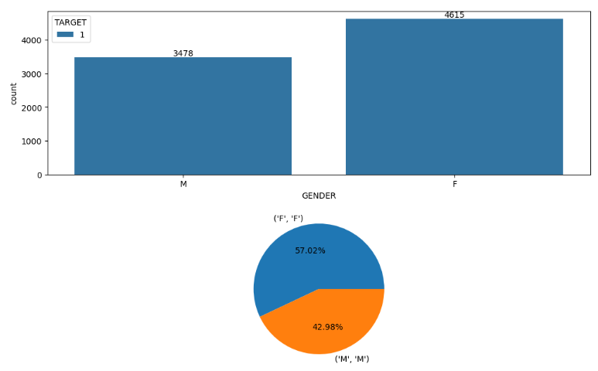
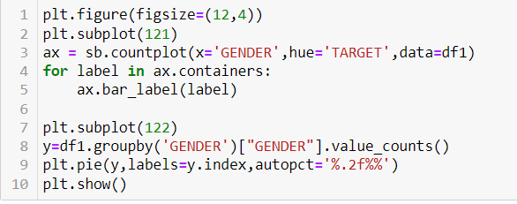
Step 7:
Gender wise high possibility defaulters
input
output
Conclusion: We can say that females are more likely to become defaulter than male

Slide 15
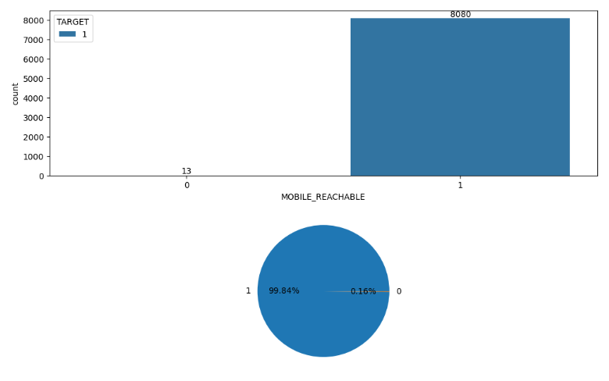
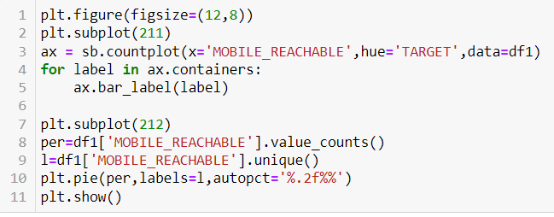
Step 8:
Mobile Reachable wise high possibility defaulters
input
output
Conclusion: We can say that even if person provide his mobile no. and reachable they can more likely to be become defaulter

Slide 16
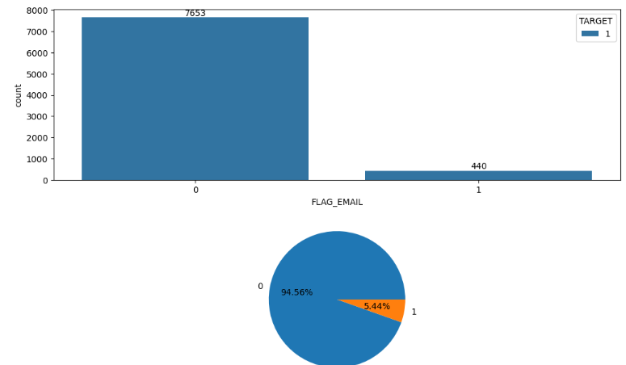
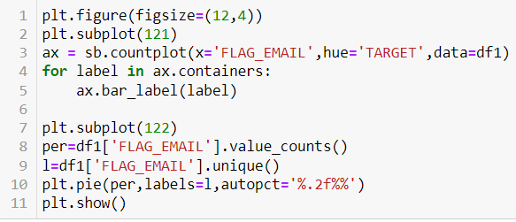
Step 9:
Email Flag wise high possibility defaulters
input
output
Conclusion: We can say that person who do not provide the email address are more likely to become defaulter

Slide 17
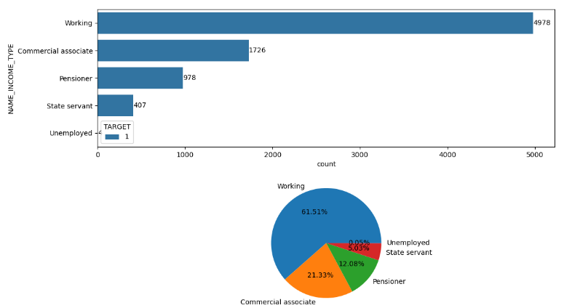
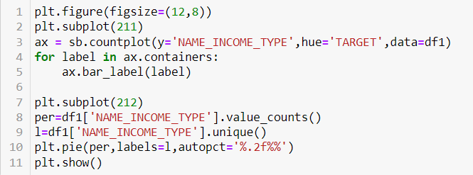
Step 10:
Income Type wise high possibility defaulters
input
output
Conclusion: We can say that person who is working income type is more prone to be defaulter

Slide 18
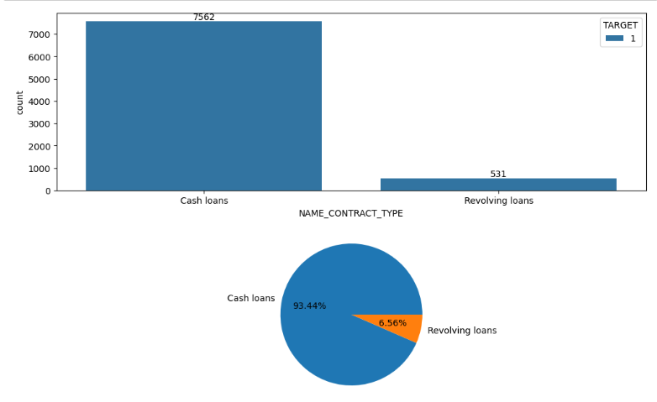
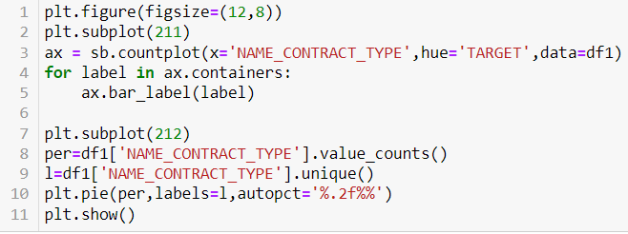
Step 11:
Contract Type wise high possibility defaulters
input
output
Conclusion: People who are having cash loans contract type are prone to be defaulter

Slide 19
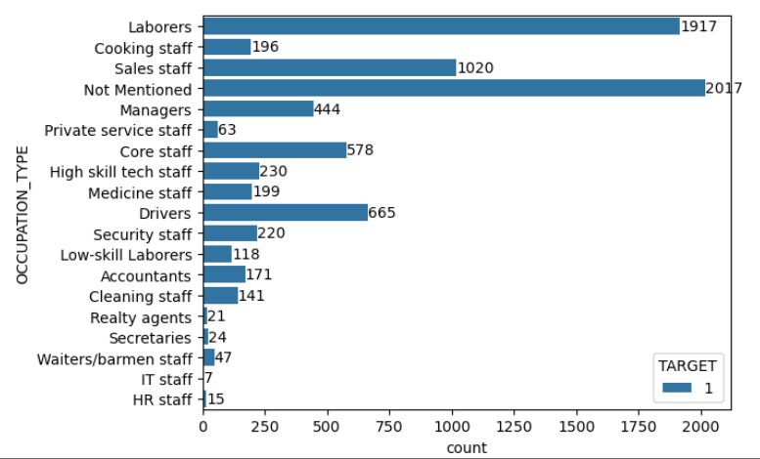
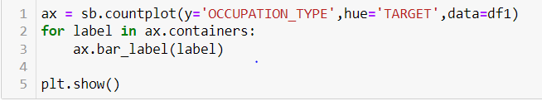
Step 12:
Occupation Type wise high possibility defaulters
input
output
Conclusion: People who do not mentioned ther occupation type are prone to be defaulter

Slide 20
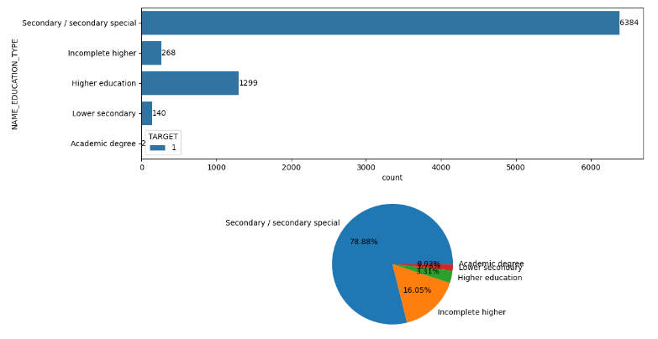
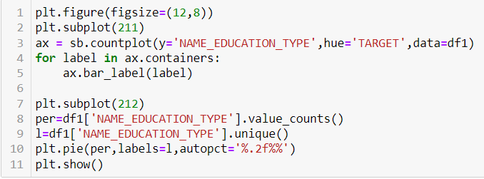
Step 13:
Education Type wise high possibility defaulters
input
output
Conclusion: People who are had moderate level of education are prone to be defaulter

Slide 21
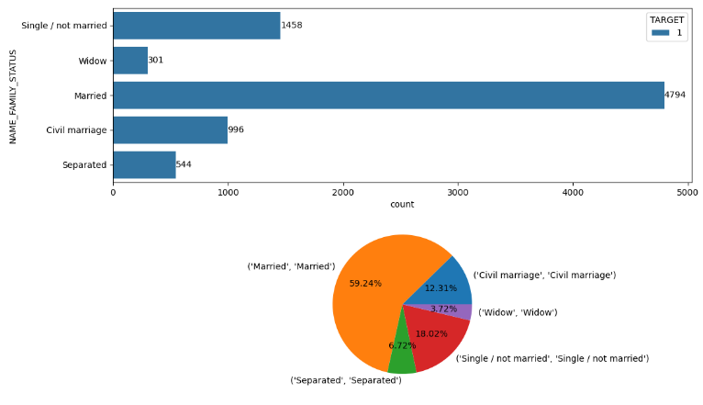
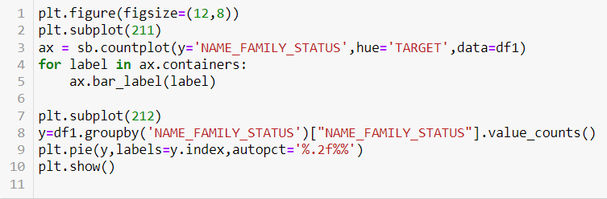
Step 14:
Family Status Type wise high possibility defaulters
input
output
Conclusion: There are people how might become defaulter who are Married

Slide 22
Final conclusion
As we can see from above assumption who can become defaulter if the person has less matching of the data are less probability to become defaulter
Below table some show column name and values which have high probability of person becoming defaulter
Column | Value
Gender | Female
Mobile_Rechable | 1
Flag_Type | 0
Income_Type | Working
Contract_Type | Cash_loan
Occupation_Type | Null/Not Mentioned
Family_Status | Married

Slide 23
THANK YOU

